Slide 1
1. FUNDAMENTALS OF COMPUTER
PRESENTED BY S.R.Zameer

Slide 2
What is a computer?
Computer System is an electronic data processing device which does the following:
Accept and store an input data.
Process the data input.
And output the processed data in required format.

Slide 3
Advantages of a Computer
High speed
Accuracy
Storage capacity
Diligence
Versatility
Reliability

Slide 4
High speed
Computer is a very fast device.
It is capable of performing addition of very big data.
The computer has units of speed in microsecond, nanosecond.
It can perform millions of calculations in a few seconds as compared to man who can spend many months for doing the same task.

Slide 5
Accuracy
In addition to being very fast, computer are very accurate.
The computer has performed calculations 100% error free.
Computers perform all jobs with 100% accuracy.

Slide 6
Storage Capacity
Memory is a very important characteristic of computers.
The computer has much more storage capacity than human beings.
It can store large amount of data.
It can store any type of data such as images, videos, text, audio and any other type.

Slide 7
DILIGENCE
Unlike human beings, a computer is free from monotony, tiredness and lack of concentration.
It can work continuously without creating any error and boredom.
It can do repeated work with same speed and accuracy.

Slide 8
VERSATILITY
A computer is a very versatile machine.
A computer is very flexible in performing the jobs to be done.
This machine can be used to solve the problems relating to various different fields.

Slide 9
RELIABILITY
A computer is a reliable machine.
Modern electronic components have failure free long lives.
Computers are designed to make maintenance easy.

Slide 10
Applications of Computer
Business
Banking
Insurance
Education
Marketing
Health care
Engineering design
Military
Communication
Government applications

Slide 11

FATHER OF COMPUTERS
CHARLES BABBAGE

Slide 12
Generations of a computer
Generation in computer terminology is a change in technology a computer is/was being used.
Initially, the generation term was used to distinguish between varying hardware technologies. But nowadays, generation includes both hardware and software, which together make up an entire computer system.

Slide 13
Following are the main five generations of computers
First generation
Second generation
Third generation
Fourth generation
Fifth generation

Slide 14
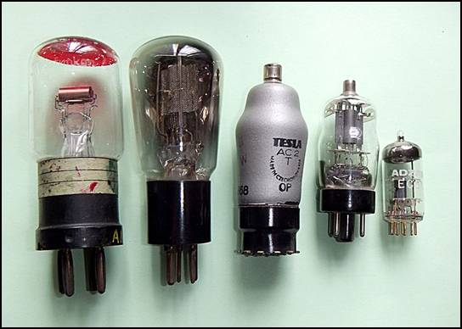
First Generation
The period of first generation : 1946-1959. Vacuum tube based.
Supported Machine language only
Very costly
Generate lot of heat
Slow Input/output device
Huge size

Slide 15
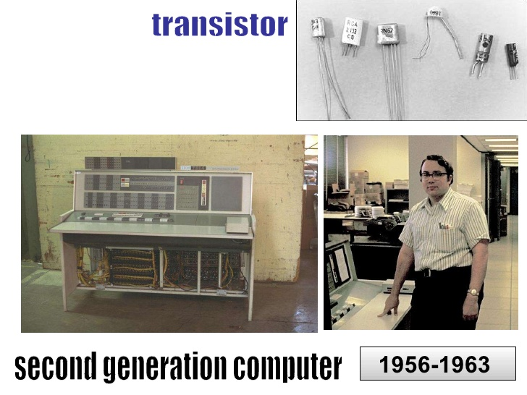
Second Generation
The period of second generation : 1959-1965 Transistor based.
Reliable as compared to First generation computers
Smaller size as compared to First generation computers

Slide 16
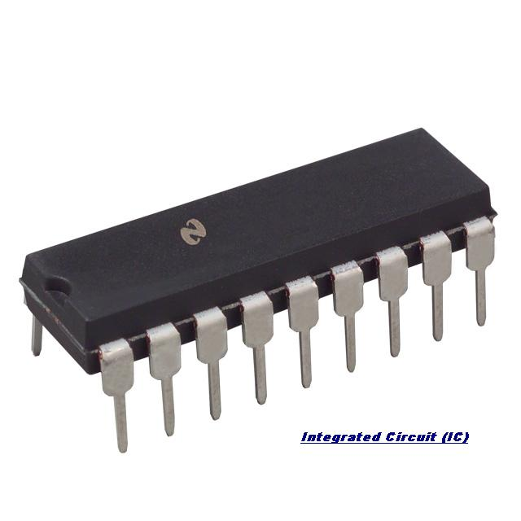
Third Generation
The period of third generation : 1965-1971 Integrated Circuit based.
Smaller size
Generate less heat
Faster
Lesser maintenance
Still costly

Slide 17
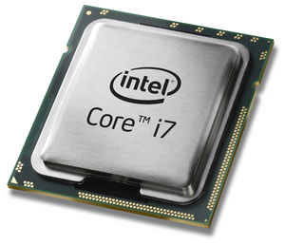
Fourth Generation
The period of fourth generation : 1971-1980 VLSI microprocessor based.
Very cheap
Portable and reliable
Use of PC's
Very small size

Slide 18
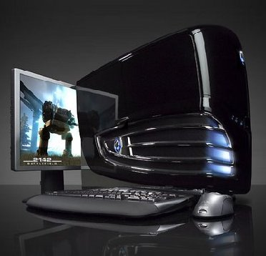
Fifth Generation
The period of fifth generation : 1980-onwards ULSI microprocessor based
Robotics
Neural networks
Game Playing

